Slide 1
Stock Recommendation System
Recommending Similar Stocks
Himani Amrish Shah
Inavamsi B Enaganti

Slide 2
Introduction
Research Project
Lot of Math
Quite a few Failures
Some successes and insights
Input: Set of Stocks
Output: Similar Stocks
Notes:
Research
What it does
Got various insights from the clusters.
Not a perfecct rec system

Slide 3
Literature survey
[1]”A stock market portfolio recommender system based on association rule mining”, Applied Soft Computing, Volume 13, Issue 2, February 2013, Pages 1055-1063,by PreetiParanjape-Vodite and UmeshDeshpande
[2]”Stock Market Investment Advice: A Social Network Approach”,N. Koochakzadeh , K. Kianmehr ,A. Sarraf ,R. Alhajj ,
[3]”Clustering in stock market based on fractal theory” ,Zeng Zhen, Peng Hong, Zeng Hiu
[4]”Clustering Stock Market Companies via K- Means algorithm” ,Mansoor Momeni, Maryam Mohseni, Mansour Soofi
[5]” Stock Price Prediction based on Stock Big Data and Pattern Graph Analysis”, Seungwoo Jeon1, Bonghee Hong1, Juhyeong Kim1 and Hyun-jik Lee2
[6]”Flock by Leader” - Abdelghani Bellaachia, Anasse Bari
[7]”Fractional Differencing” JRM Hosking 1981

Slide 4
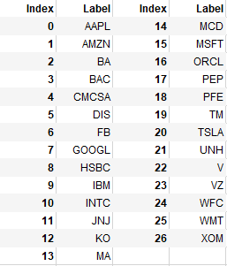
Data
NASDAQ and NYSE data of 27 stocks has been used in this project.
The dataset has daily data for the past 5 years.
And has attributes like Date, Highest price,
Lowest price, Opening price, Closing price and Volume traded.

Slide 5
Workflow
1. Preprocess data
Clean Data by removing Missing Values
Feature Selection
Standardize the Data
3. Apply Clustering algorithms like K-Means, Hierarchical Clustering, Swarm Clustering, KMedoids/PAM clustering, KMeans++, MeanShift Clustering and Fractal Dimensions using different measures.
4. Mining Association rules from weighted clusters to recommend.

Slide 6
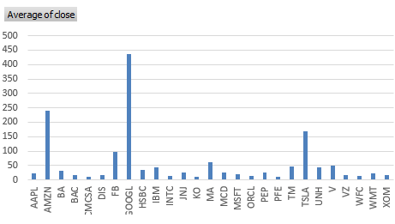
Preprocessing
Missing Values
Feature Selection-Closing Price
Data Normalization
1 Percentage change in price
2 Min-Max scaling:
3. Standardization scaling

Slide 7
Clustering Model
K-Means / K-Means++
Hierarchical
MeanShift Clustering
PAM Clustering
Swarm Clustering
Clustering based on Fractal Dimension

Slide 8

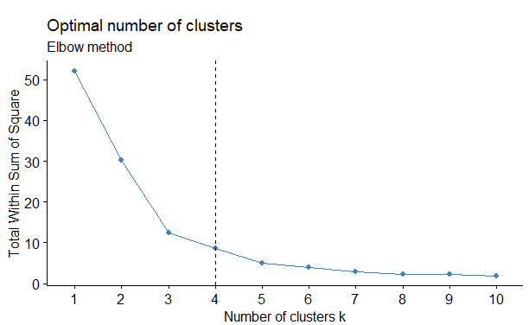
Optimal K value
Elbow Method
Compute clustering algorithm (e.g., k-means clustering) for different values of k. For instance, by varying k from 1 to 10 clusters
For each k, calculate the total within-cluster sum of square (wss)
Plot the curve of wss according to the number of clusters k.
The location of a bend (knee) in the plot is generally considered as an indicator of the appropriate number of clusters.
Notes:
The elbow method looks at the percentage of variance explained as a function of the number of clusters: One should choose a number of clusters so that adding another cluster doesn’t give much better modeling of the data. More precisely, if one plots the percentage of variance explained by the clusters against the number of clusters, the first clusters will add much information (explain a lot of variance), but at some point the marginal gain will drop, giving an angle in the graph. The number of clusters is chosen at this point, hence the “elbow criterion”.

Slide 9
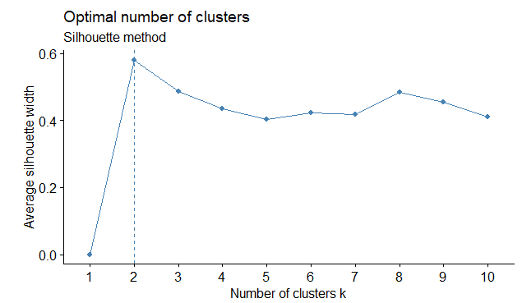
Average silhouette method
Compute clustering algorithm (e.g., k-means clustering) for different values of k. For instance, by varying k from 1 to 10 clusters
For each k, calculate the average silhouette of observations (avg.sil)
Plot the curve of avg.sil according to the number of clusters k.
The location of the maximum is considered as the appropriate number of clusters.
Coeff = b(i)- a(i) / max(a(i),b(i))
Notes:
For an example (i) in the data, lets define a(i) to be the mean distance of point (i) w.r.t to all the other points in the cluster its assigned (A). We can interpret a(i) as how well the point is assigned to the cluster. Smaller the value better the assignment.
Similarly, lets define b(i) to be the mean distance of point(i) w.r.t. to other points to its closet neighboring cluster (B). The cluster (B) is the cluster to which point (i) is not assigned to but its distance is closest amongst all other cluster.
For each observation ii, calculate the average dissimilarity aiai between ii and all other points of the cluster to which i belongs.
For all other clusters CC, to which i does not belong, calculate the average dissimilarity d(i,C)d(i,C) of ii to all observations of C. The smallest of these d(i,C)d(i,C) is defined as bi=minCd(i,C)bi=minCd(i,C). The value of bibi can be seen as the dissimilarity between ii and its “neighbor” cluster, i.e., the nearest one to which it does not belong.
Finally the silhouette width of the observation ii is defined by the formula: Si=(bi−ai)/max(ai,bi)Si=(bi−ai)/max(ai,bi).

Slide 10
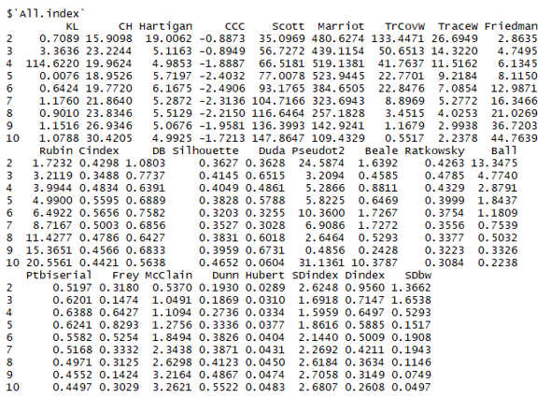
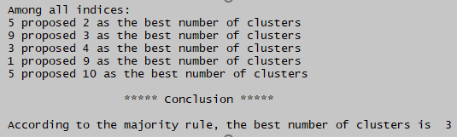
Gap Statistic Method
Hartigan Method
Scott Method
Marriot Method
Friedman Method
...

Slide 11
Basis of Clustering:
Volatility: Standard deviation over a time frame
Percentage change in key indices
Popularity - Total amount in value traded
Notes:
No intuitive sense
Didnt give good results

Slide 12
Based on Standard Deviation (Volatility)
For each stock,
-Divide the data into period of 4 months
-Determine each period's standard deviation.
-Calculate the mean of these deviations by assigning higher weights to the recent deviations to get the final standard deviation for that stock
-Cluster the stocks on basis of this final standard deviation value

Slide 13
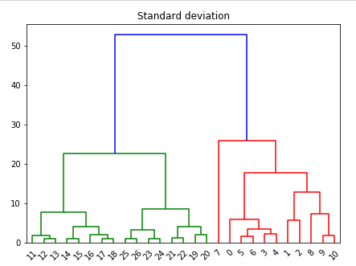
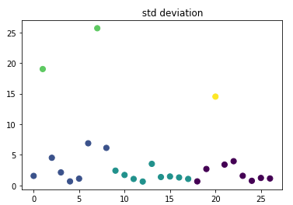
Output from KMeans++/KMeans/Hierarchical

Slide 14

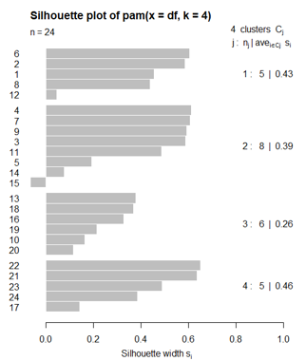
PAM
Algorithm
Build phase:
1. Choose k entities to become the medoids, or in case these entities were provided use them as the medoids;
2. Calculate the dissimilarity matrix if it was not informed;
3. Assign every entity to its closest medoid;
Swap phase:
4. For each cluster search if any of the entities of the cluster lower the average dissimilarity coefficient, if it does select the entity that lowers this coefficient the most as the medoid for this cluster;
5. If at least one medoid has changed go to (3), else end the algorithm
Notes:
F(x) is the main function to minimize
d(i,j) is the dissimilarity measurement between the entities i and j
zij is a variable that ensures that only the dissimilarity between entities from the same cluster will be computed in the main function

Slide 15
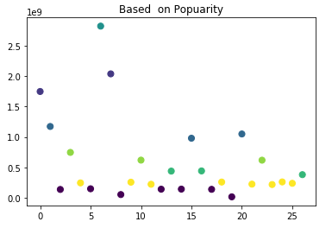
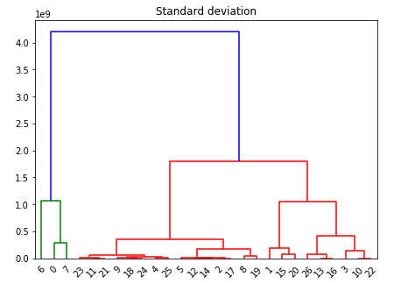
Based on Popularity
Popular stocks are
AAPL,AMZN,FB,GOOGL,MSFT,TSLA

Slide 16
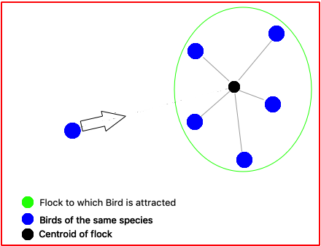
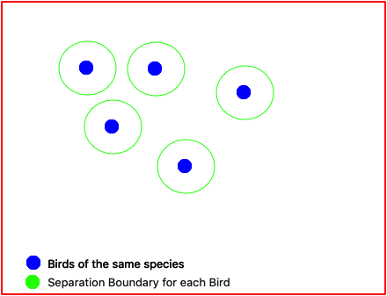
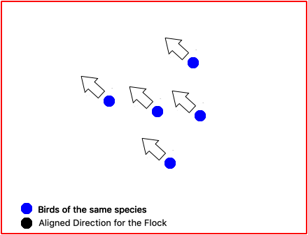
Swarm Clustering
Cohesion Separation Alignment

Slide 17
Innovations
Torus
Momentum
Adjusting Separation Distance
Visibility distance

Slide 18
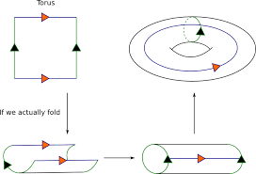
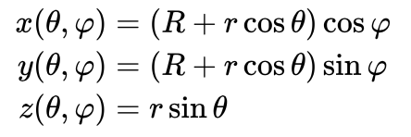

Slide 19
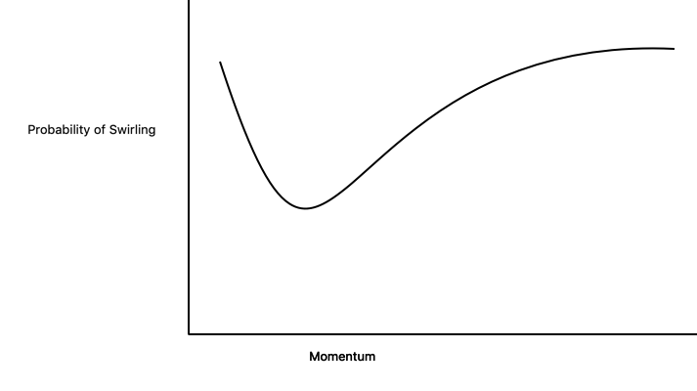
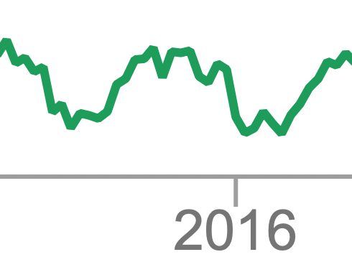
Momentum
Swirling effect
Reason
Dec 24 2015 - March 24 2016

Slide 20
Adjusting Minimum Separation Distance
Use a N x N grid
Every cell in the grid was scaled to the size of Minimum Separation distance.
Problems
Speed Affected
Direction Affected ( Limited to only 4)
Solution
Sampling and Monte Carlo methods

Slide 21
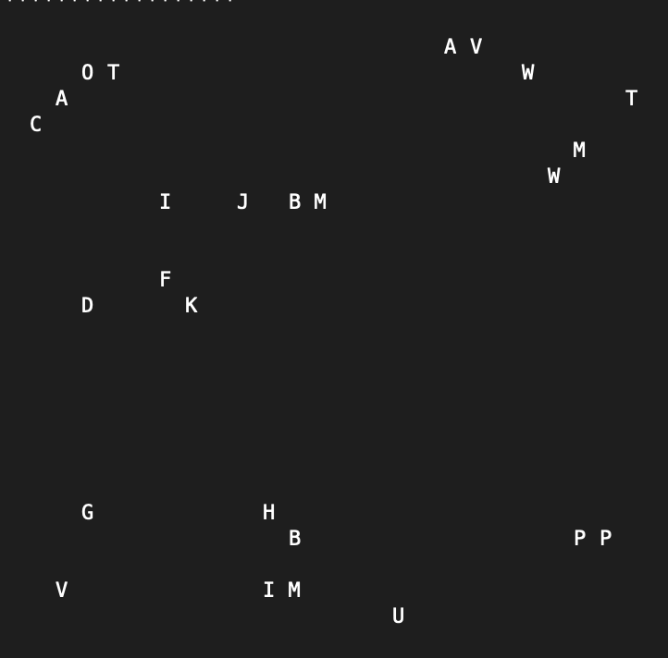

Slide 22
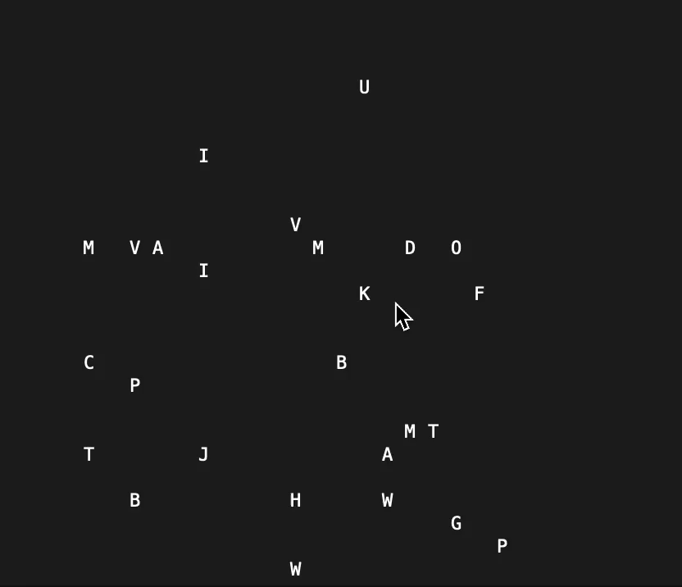

Slide 23
Clustering Based on Fractal Dimension
Fractal is a detailed, recursive, and infinitely self-similar mathematical set whose Hausdorff dimension strictly exceeds its topological dimension.
Fractal Dimension : Ratio measuring a statistical index of how details of an object changes with scale.

Slide 24
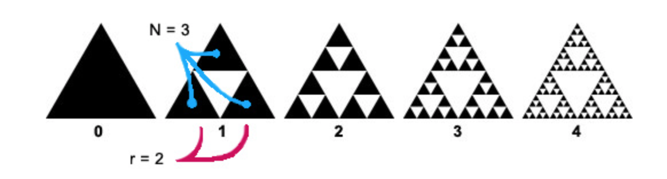
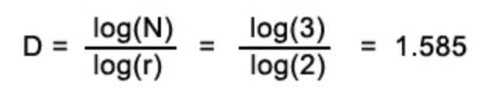

Slide 25
Methods
Simulation using the Shadow Method.
Neural Net
Slope method - Richardson effect
----------------------------------------------
Dimension Calculation
Higuchi Dimension
Box Counting Dimension
Information Dimension
Correlation Dimension

Slide 26
Higuchi Dimension
H = log(L(k)) / log k
L(k) - Total length (Time series is 1 Dimensional)
K - Scale
---------------------------
Parameter Used
Scale size : k= 2

Slide 27
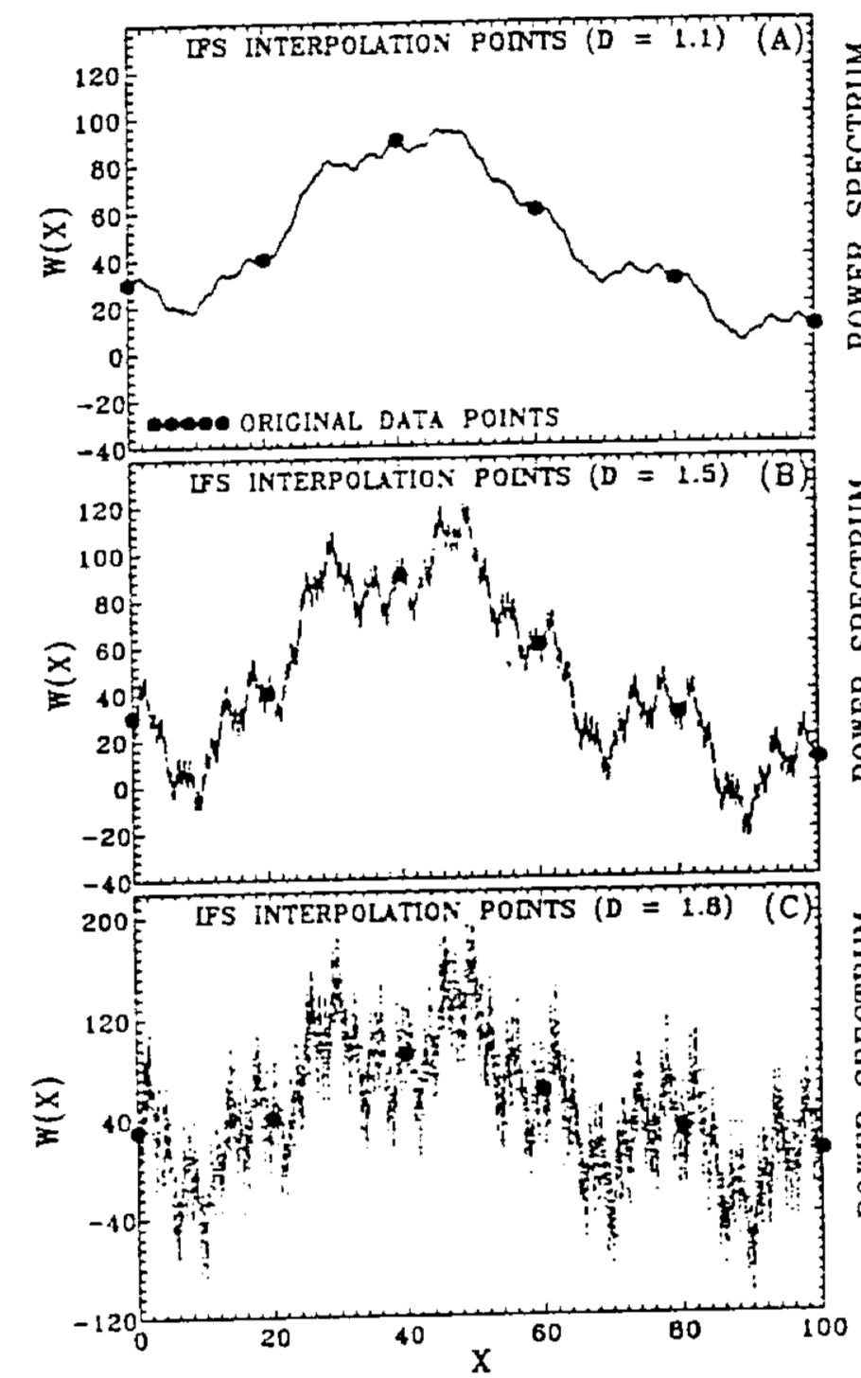
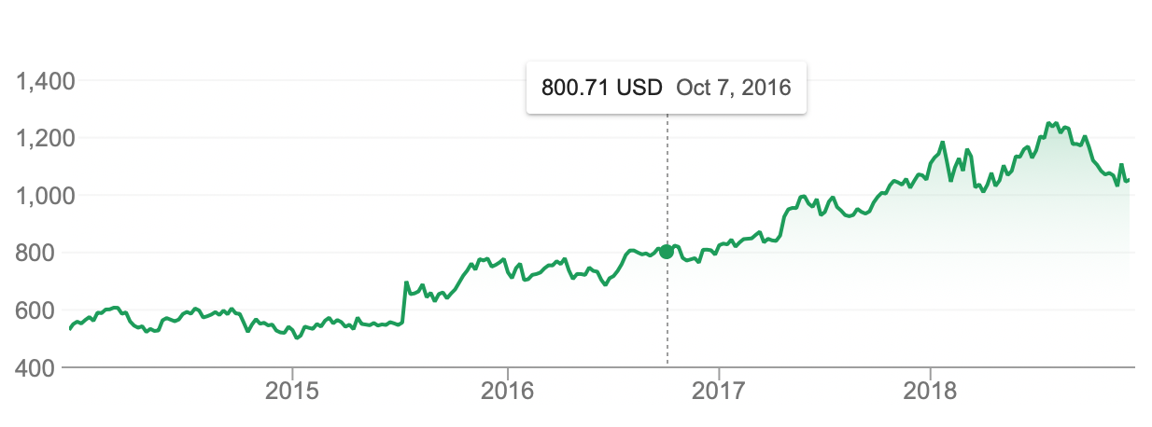
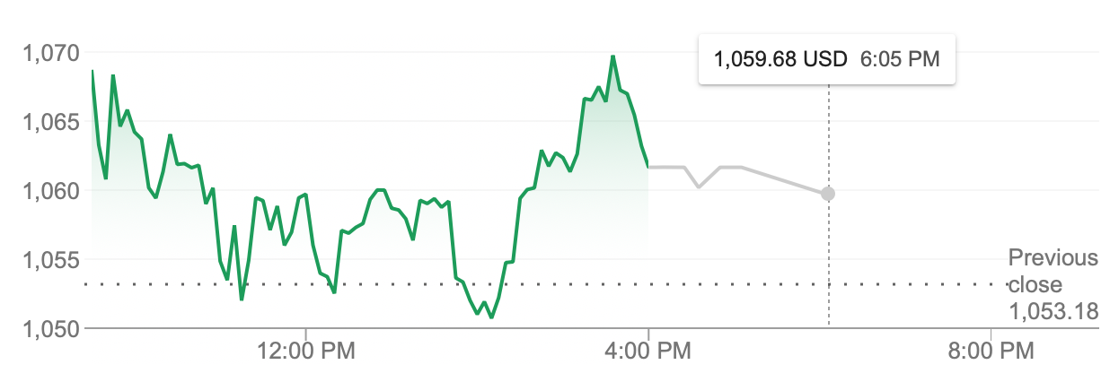

Slide 28
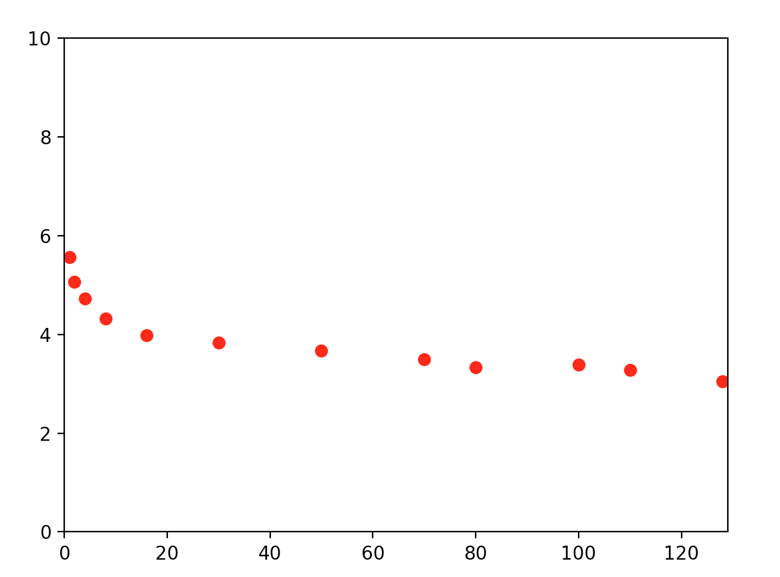
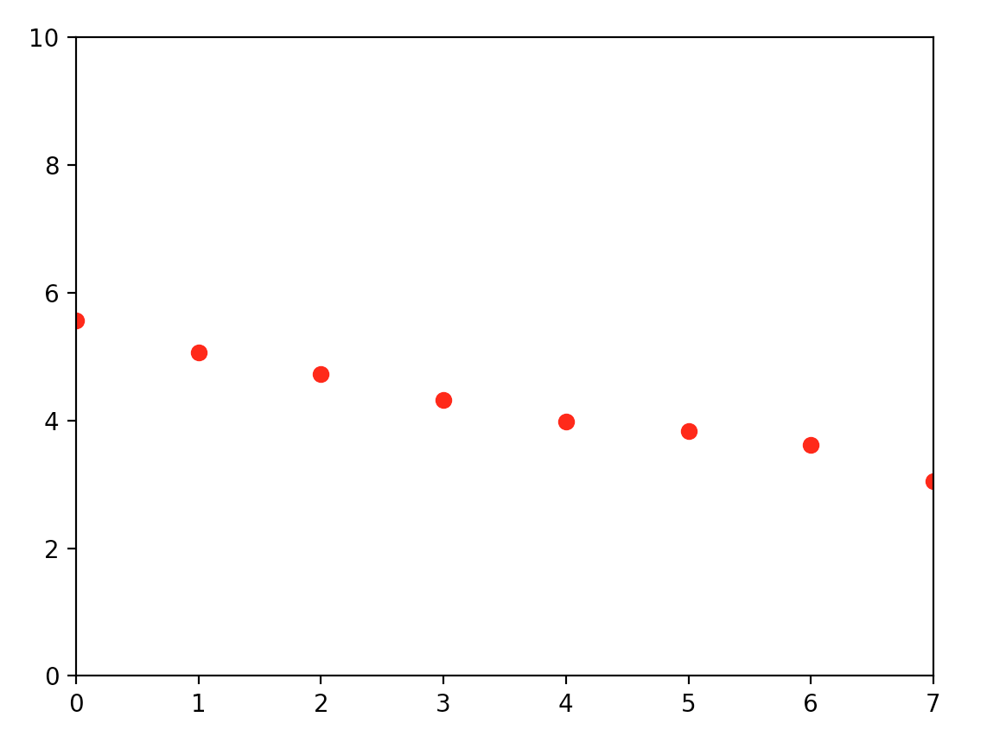

Slide 29
Insights
Why care about the Fractal Dimension?
Stocks follow the power law.
Clustering based on slope : 6 Clusters, 4 Outliers
Structure of a stock is maintained throughout.
Daily fluctuations can forecast the weekly trend.
Stocks with similar dimension will follow a similar trend.

Slide 30
Recommendation System (Content based filtering)
1. Obtain a huge number of clusters.
2. We mine association rules and store them beforehand.
3. Given an input set of Stocks, we recommend similar stocks using the association rules.

Slide 31
Obtaining the Association Rules
Assign a weight to each cluster based on duplicates and relevance. (requires a lot of business understanding)
We apply weighted Apriori.
Each cluster is treated as a transaction
Normal Apriori - weight of each transaction is 1, here it is according to the clustering algorithm used to create cluster.
Obtain frequently occuring subsets
Mine associations from frequently occuring subsets

Slide 32
Result
Don’t buy Tesla unless you are feeling lucky. (Outlier in almost all clusters)
We can use this model to detect anomalies in the stock Market.
A few of the association rules:
Minimum Support=sqrt(N), Confidence=60%
GOOGL <=> AMZN
APPL => INTC, J&J
BA=>HSBC,KO
WFC<= >WMT,XOM

Slide 33
Future Scope
1. Scale
2. Extend to Futures, Options and Securities.
3. A full Investment portfolio
Notes:
Our model is scalable and not data dependant,hence we would broaden the scope of the

